Slide 1

Anti-Money laundering with blockchain
Know Your customer
Jessica Carmichael | Elizabeth Morris | Daniel Lynes | Manjari Shukla
Notes:
Jessica Carmichael
Elizabeth Morris
Daniel Lynes
Manjari Shukla

Slide 2
Objectives
The purpose of this project is to explore the integration of blockchain into Anti-Money Laundering (AML) practices
We will be incorporating smart contracts into the Know Your Customer (KYC) process
The smart contract will be able to input and update information into the blockchain
Notes:
The objective of this project is to explore the possibilities of integrating blockchain into Anti-Money Laundering practices. We have used Solidity to create a smart contract to input and update information on the blockchain for the purpose of streamlining the Know Your Customer (KYC) process.

Slide 3



What is Aml and KYC?
AML refers to the global laws, regulations, and procedures that are in place to prevent the act of producing income through illegal activities
KYC are the certain details that a business keeps as an end criteria for the identification of customers who are interested in doing business.
According to The LexisNexis® Risk Solutions 2019 True Cost of AML Compliance Study for the United States and Canada, the annual AML compliance costs for the United States and Canadian financial institutions totaled $31.5 billion USD
Notes:
AML refers to the global laws, regulations, and procedures that are in place to prevent the act of producing income through illegal activities.
KYC is a component of AML; they are the certain details that the business keeps as an end criteria for the identification of customers who are interested in doing business with them.
According to The LexisNexis® Risk Solutions 2019 True Cost of AML Compliance Study for the United States and Canada, the annual AML compliance costs for the United States and Canadian financial institutions totaled $31.5 billion USD

Slide 4

Challenges with KYC
Challenges with AML
Terrorist Financing
Identity Theft
Corruption
Tax Avoidance
Technology
Speed
Volume
Notes:
Some predominant issues that are being faced by the current KYC compliances include issues related to corruption, terrorist financing, identity thefts and illegal tax avoidance.
The issue with the current AML procedures are that they are not able to keep pace with the evolving complexity and volume of financial transactions which becomes a problem for keeping a check on Laundering activities.

Slide 5
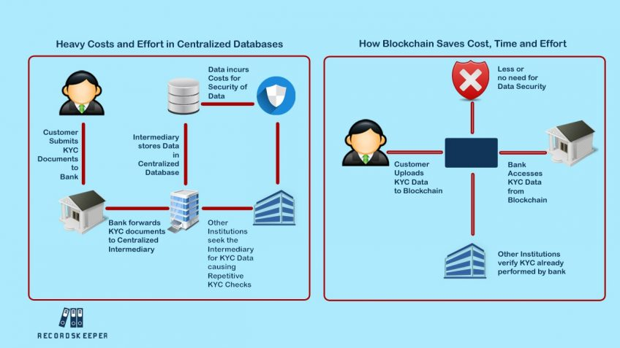
How Can Blockchain Help?
Distributed
Ledger
Automation
Encryption
Identification
Historical Records
Notes:
Blockchain technology allows for the creation of a distributed ledger that is then shared to all users on the network. Utilizing Blockchain as a distributed ledger system has the potential to unlock the advantages of automated processes such as reducing compliance errors. A blockchain-based registry would not only remove the repetitive efforts of implementing KYC checks, but the ledger would also enable encrypted updates to client accounts to be distributed in near real-time.
A KYC utility system based on blockchain technology will enable the financial and banking sectors to emancipate the process of identification verification. Currently, our data is collected and stored in a centralized system. With the introduction of blockchain solutions to handle the KYC process, data will be available on a decentralized network and can, therefore, be accessed by third parties directly after permission has been given.
This blockchain-based KYC system will also offer better data security by ensuring that data access is only made after a confirmation or permission is received from the relevant authority. This will eliminate the chance of unauthorized access and subsequently give individuals greater control over their data.
This ledger will provide a historical record of all documents shared and compliance activities undertaken for each client. Blockchain technology is also helpful in identifying entities attempting to create fraudulent histories. Within the provisions of data protection regulation, the data in the blockchain is immutable and could be analysed to identify irregularities - this can directly target criminal activity.

Slide 6
Building the KYC System
A Smart contract is created to register KYC information and update the data. The contract tracks the validity of the KYC details; where the information is valid up to `365 days` after which one needs to update the information again.
This contract is deployed in Remix IDE.
A new directory is created where a Pinata API Key, and Secret API Key are used to deploy the smart contract and the WEB3 provider uri.
The deployed contract ABI is copied and stored in a JSON file.
Notes:
A KYC System is built using a command line interface that will upload and pin KYC reports to IPFS via Pinata, permanently storing them on-chain by using the register KYC function in the KYC smart contract.

Slide 7
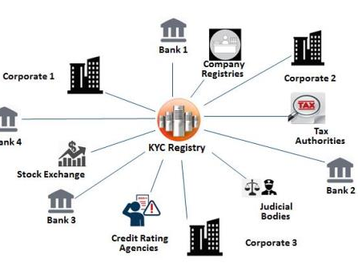
Conclusion
Blockchain based KYC systems will significantly reduce compliance costs
This technology will allow banks and other financial organizations to rely on a more secure and unified model of data handling
Notes:
In the future, blockchain-based KYC utilities will help bring cost savings to any industry that relies on identity verification. This is because the technology will allow banks and other financial organizations to rely on a more secure organized unified model of data handling.

Slide 8

Thank You! Questions?
Jessica Carmichael
Elizabeth morris
Daniel lynes
Manjari shukla
Notes:
Jessica Carmichael
Elizabeth Morris
Daniel Lynes
Manjari Shukla

